Slide 1
Networking
Sockets

Slide 2
Previously, in IMM120
Why modes?
Lots of positive feedback on the videos
I will do atleast one next week
Languages?
Javascript, HTML, CSS
Collaboration
Function Pressed

Slide 3

Warm-Up
Make an Inception Button

Slide 4
Warm-Up
Move the button randomly after being clicked

Slide 5
Networking
Let’s play a game

Slide 6
Jackbox Party Pack
HOST
4
1
3
2

Slide 7
The Normal Way The Web Works
1
2
REQUEST
3
RESPONSE
4

Slide 8
What We Need To Do
A
MESSAGE
B

Slide 9
Web Sockets
1
2
REQUEST
3
ACCEPT
4
SOCKET
ACCEPT
Notes:
Allows information to go back and forth

Slide 10
Web Sockets
Allow information to be sent either way at any time.
You use websockets by listening for events on them.
Events are similar to mousePressed
It’s similar to a subscription (Twitter or YouTube notification)

Slide 11
Sockets.io
This is the library that we’re using to use web sockets.
Once a socket is made, we can emit (send) and listen (receive).

Slide 12
What We Need To Do
A
MESSAGE
B

Slide 13
What Sockets.io Allows Us To Do
A
MESSAGE
MESSAGE
B

Slide 14
Sockets.io
socket.emit(“action”, data);
socket.on(“action”, function(data) {
// do something with the data
});
A
EMIT
ON
B

Slide 15
5
4
1
emit
2
3
Notes:
There’s a small problem: how can the server distinguish between people you want to send a message to and people you don’t?
You send a message to the server…

Slide 16
5
4
1
2
3
Notes:
…and the server sends it to everyone connected to the server. Including the sender! This causes three problems. First, it’s a lot of traffic. Only computers that are listening for the event you emitted, but every computer is receiving and parsing

Slide 17
Sockets Template
https://tinyurl.com/IMM120net

Slide 18
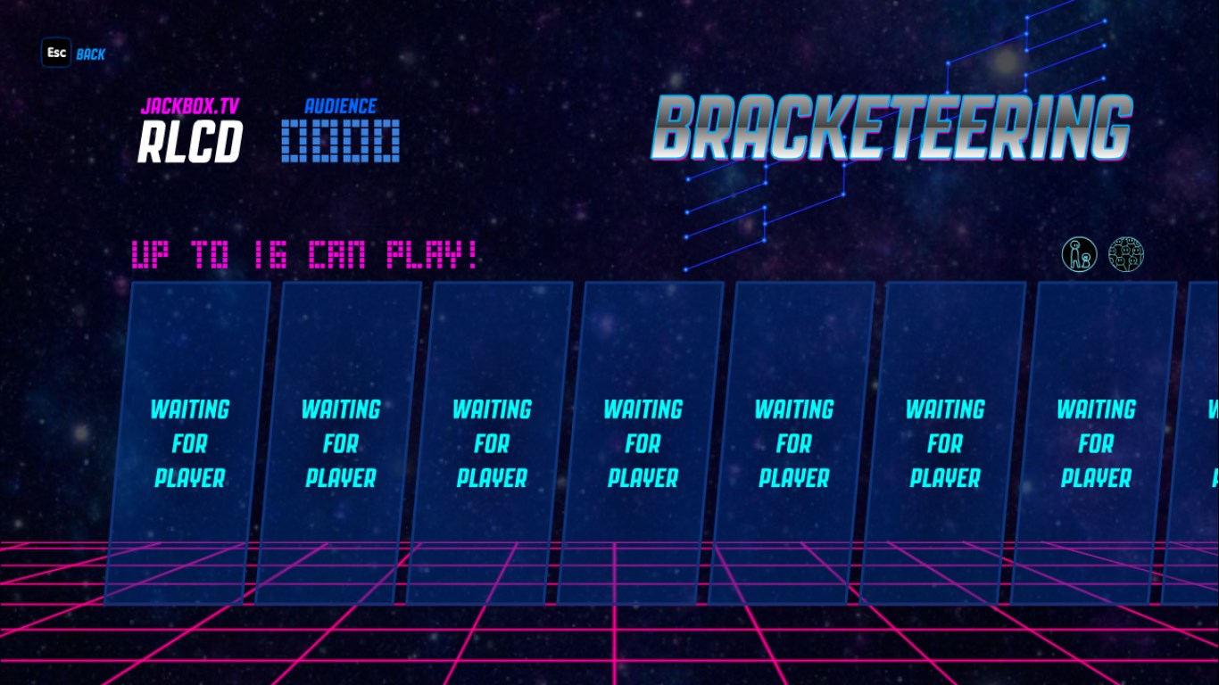
Rooms

Slide 19
Rooms
socket.emit(“join”, “room-code”);
Default room on my server is “imm120”.
Notes:
The way I wrote my server, this is how you join a room.

Slide 20
Rooms
A
C
A
B
A
Notes:
A server will only send a message to other computers in the same room.

Slide 21
Problem: IDs
Problem: every message is sent to every computer in the room
Including the sender
This isn’t always a problem
A problem in a multiplayer game.
Not a problem in most collaborative experiences.
Socket.io assigns an ID to every socket connection.
My server sends this data with every message (packet).
The Sockets Template saves this ID for you automatically.
Notes:
What about that sending back to yourself problem?

Slide 22
Add Your Circle To The Screen
Send an object with your position and name: { x: x, y:y, name: “Chris” }

Slide 23
Add Your Circle To The Screen
Send an object with your name
Send a color

Slide 24
Add Your Circle To The Screen
Send an object with your name
Send a color / Edit your version to display rects/tris/images.

Slide 25
Add Your Circle To The Screen
Send an object with your name
Send a color / Edit your version to display rects/tris/images.
Connect to the person next to you instead of the screen

Slide 26
Try Another Networking Idea
Pong
Shared drawing board
Chat room
Shooting Range
Hide and Seek
Tic Tac Toe

Slide 27
Midterm Project
Fall Break: Think of ideas
Week you come back (Oct 22): Finalize ideas, prototype
Week after that (Oct 29): Work on it in the lab
Following Friday (Nov 2): Due

Slide 28
Minute Survey
Oct 16th (next Tuesday) is the last day to register to vote in NJ
Hacktoberfest is still going on!
Videos next week
Sprite Sheets
Sounds
Git

